Slide 1

Designing Quantum Interfaces
for Society
WP4.4 — Mental Models for Quantum Computing
J. Derek Lomas — Assistant Professor of Positive AI
Caiseal Beardow — PhD Candidate in Human-Centered Design
Industrial Design Engineering & QuTech, TU Delft
Quantum Inspire Program Review — February 2026

Slide 2
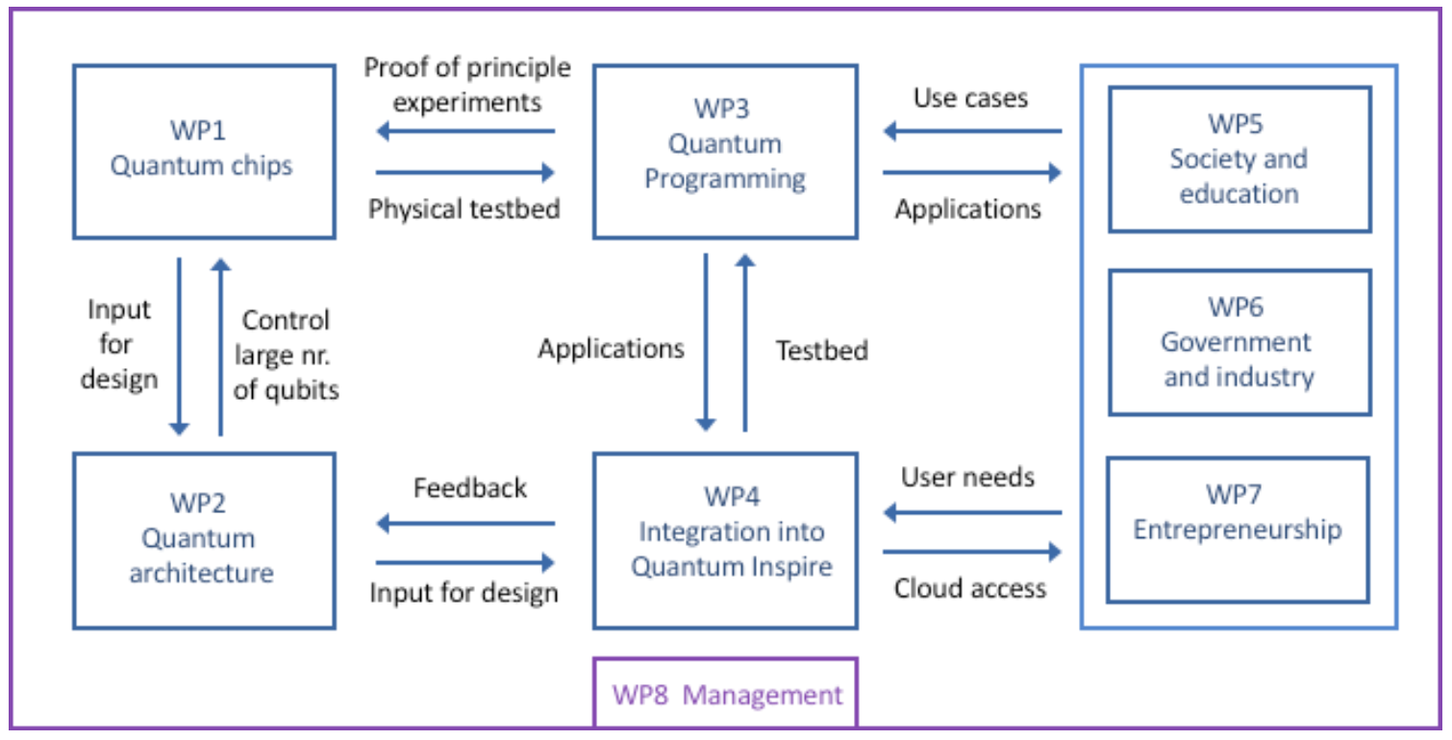
The Program
"The design of the Quantum Inspire interface is repeatedly adapted to incorporate the findings from stakeholders (WP5-7) and industrial design researchers, who investigate intuitive mental models of quantum bits and computers."

Slide 3
WP4.4 Mandate
"WP4.4 requires fundamental research on mental models for quantum computing concepts which will guide the UX/UI design."
"Deploy qualitative methods to create a common language (and shared mental models) acceptable to both experts and non-experts... technology probes, research-through-design, experience prototyping, storytelling and co-creation."
PROMISED DELIVERABLES
• "PhD thesis (month 48)" + "3 scientific publications (month 18, 30, 42)"
• "Updated user experience and interface of quantum-inspire.com (month 6, month 36)"
• "Data... available through public repositories such as 4TU or Zenodo"

Slide 4
Three Lines of Work
1. PhD Thesis
2. MSc Graduation
3. Haiqu: AI Agent
Quantum Computational Thinking — framework, metaphors, and prototype for computing-focused QC education
D'Arcangelis (2024) — "How Might ChatGPT Improve the Accessibility of Quantum Computing?"
AI-mediated quantum computing — replication study + benchmark + interactive platform
"Translate fundamental research in quantum physics and design to concrete outcomes for society via an accessible interface for quantum computers."

Slide 5

What is quantum computational
thinking and how do we teach it?
PhD RESEARCH — CAISEAL BEARDOW

Slide 6
PhD (1/5): Quantum Computational Thinking
7 KEY QC CONCEPTS
5 COMPUTATIONAL THINKING DIMENSIONS
Concept | Complexity
Superposition | Low
Entanglement | Low
Probability | Low
Measurement | Medium
Qubits | Medium
Gate operations | High
Algorithms | High
Abstraction — categorising, generalising, relating
Algorithmic thinking — decomposing, iterating, planning
Data — types, values, transforming
Logic — deducing, extrapolating, predicting
Problem-solving — adjusting, judging
Key insight: Educators frame QC bottom-up from physics. Computing learners need the inverse — top-down from algorithms.

Slide 7
PhD (2/5): Metaphor Research
WHAT EDUCATORS USE TODAY
WHAT WE DESIGNED
39 metaphors collected via interviews with QC educators:
Concept | New metaphor
Qubits | Coloured cells in a grid
Gates | Formatting cells
Superposition | Colour gradient on a cell
Entanglement | Opacity of adjacent cells
Measurement | Setting colour to a point
Probability | Manipulating colour in a gradient
Algorithms | Refining a route
Concept | Prevalent model
Algorithms | Incremental construction
Entanglement | Paired objects
Qubits | A polar object
Superposition | Expansion of resources
Scored well on explainable (4.0) and relatable (3.8) but poorly on actionable (2.6/5). They describe properties, not computations.

Slide 8
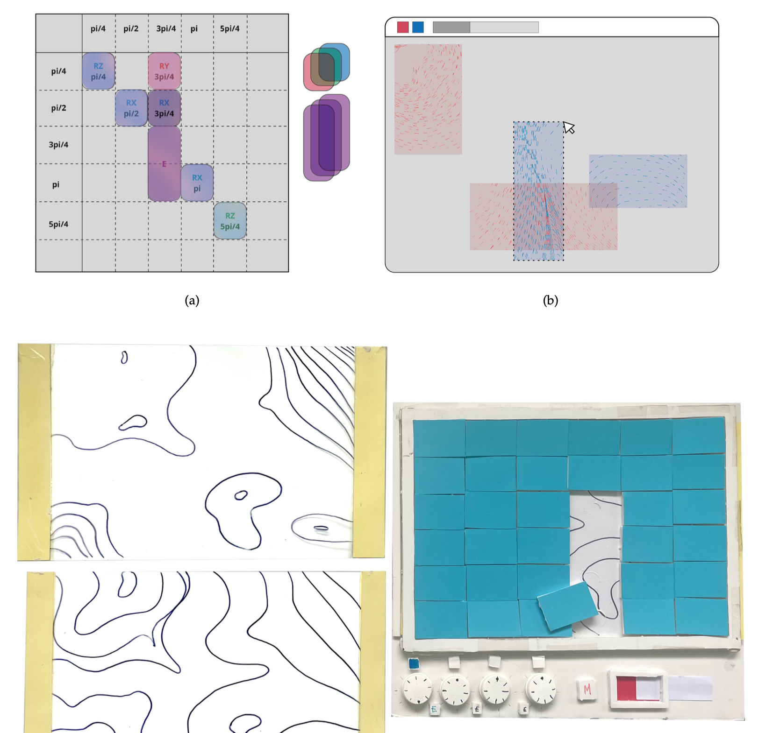
PhD (3/5): Design Iterations
From concept to functional prototype through iterative research-through-design:
Early concept sketches, physical prototyping, and digital interface exploration

Slide 9
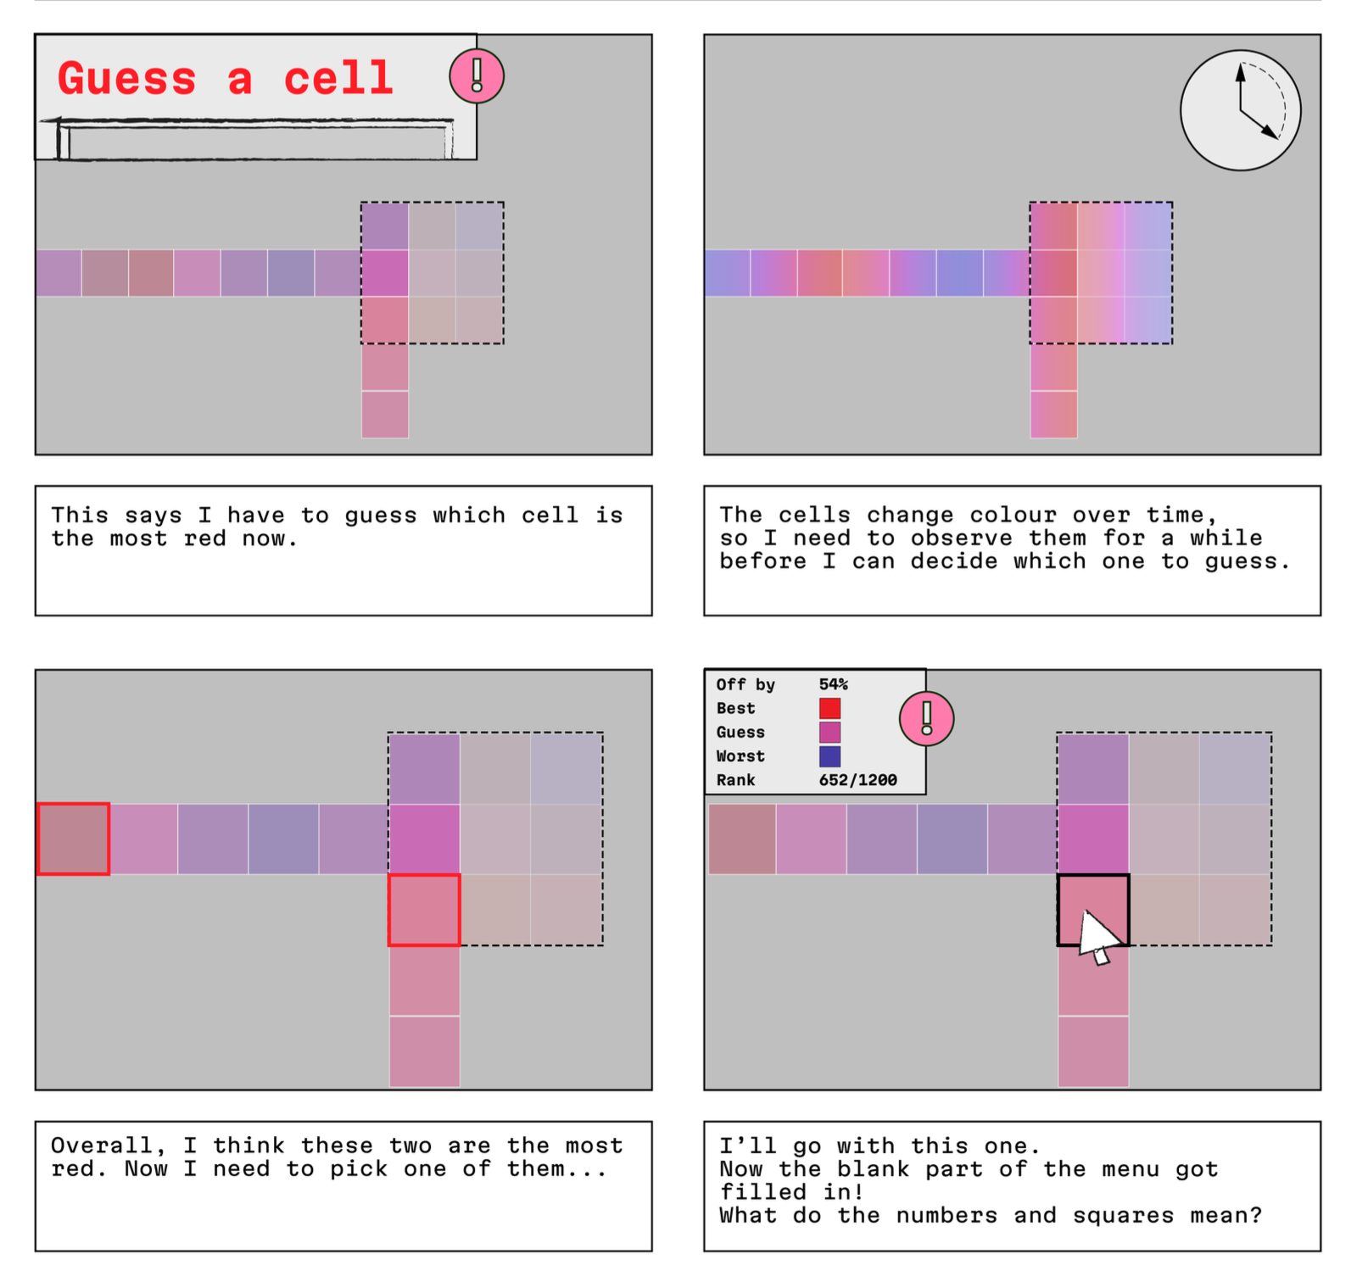
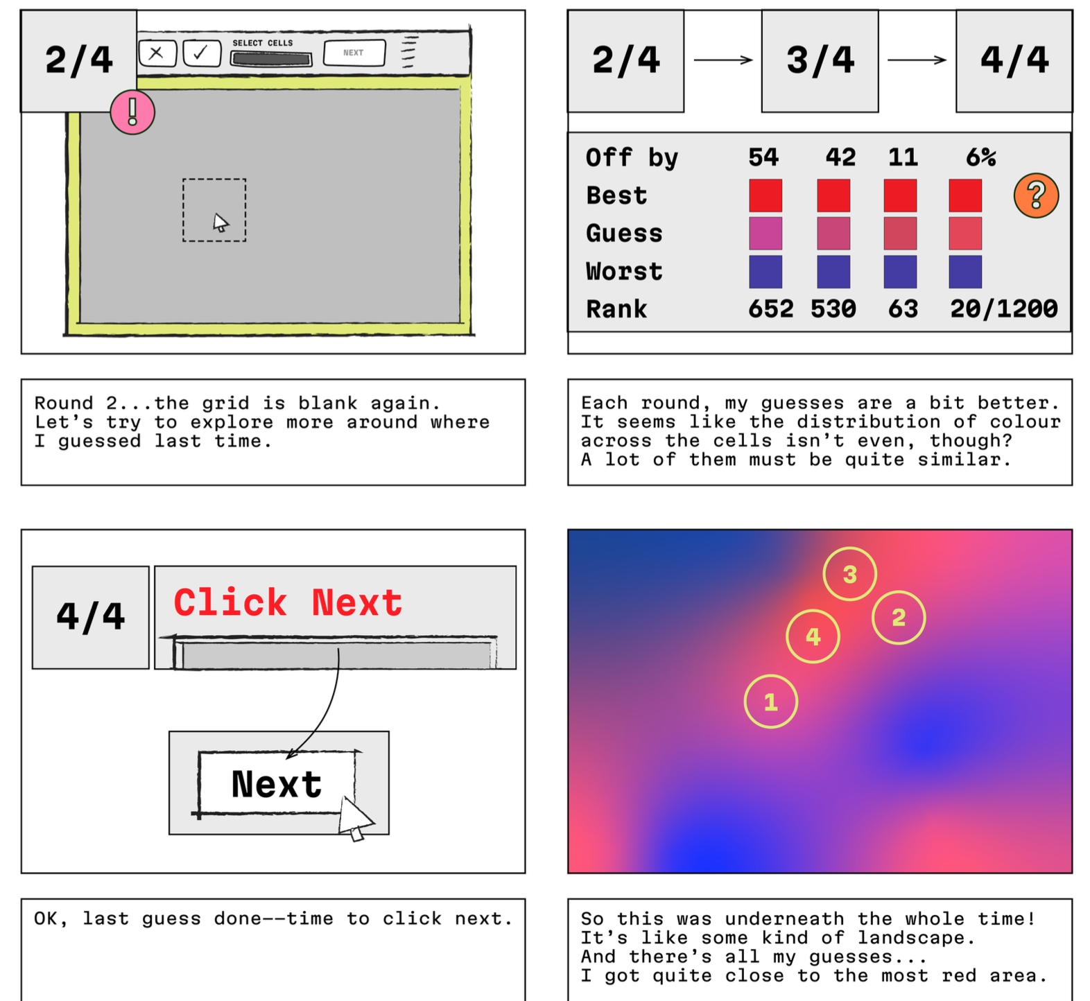
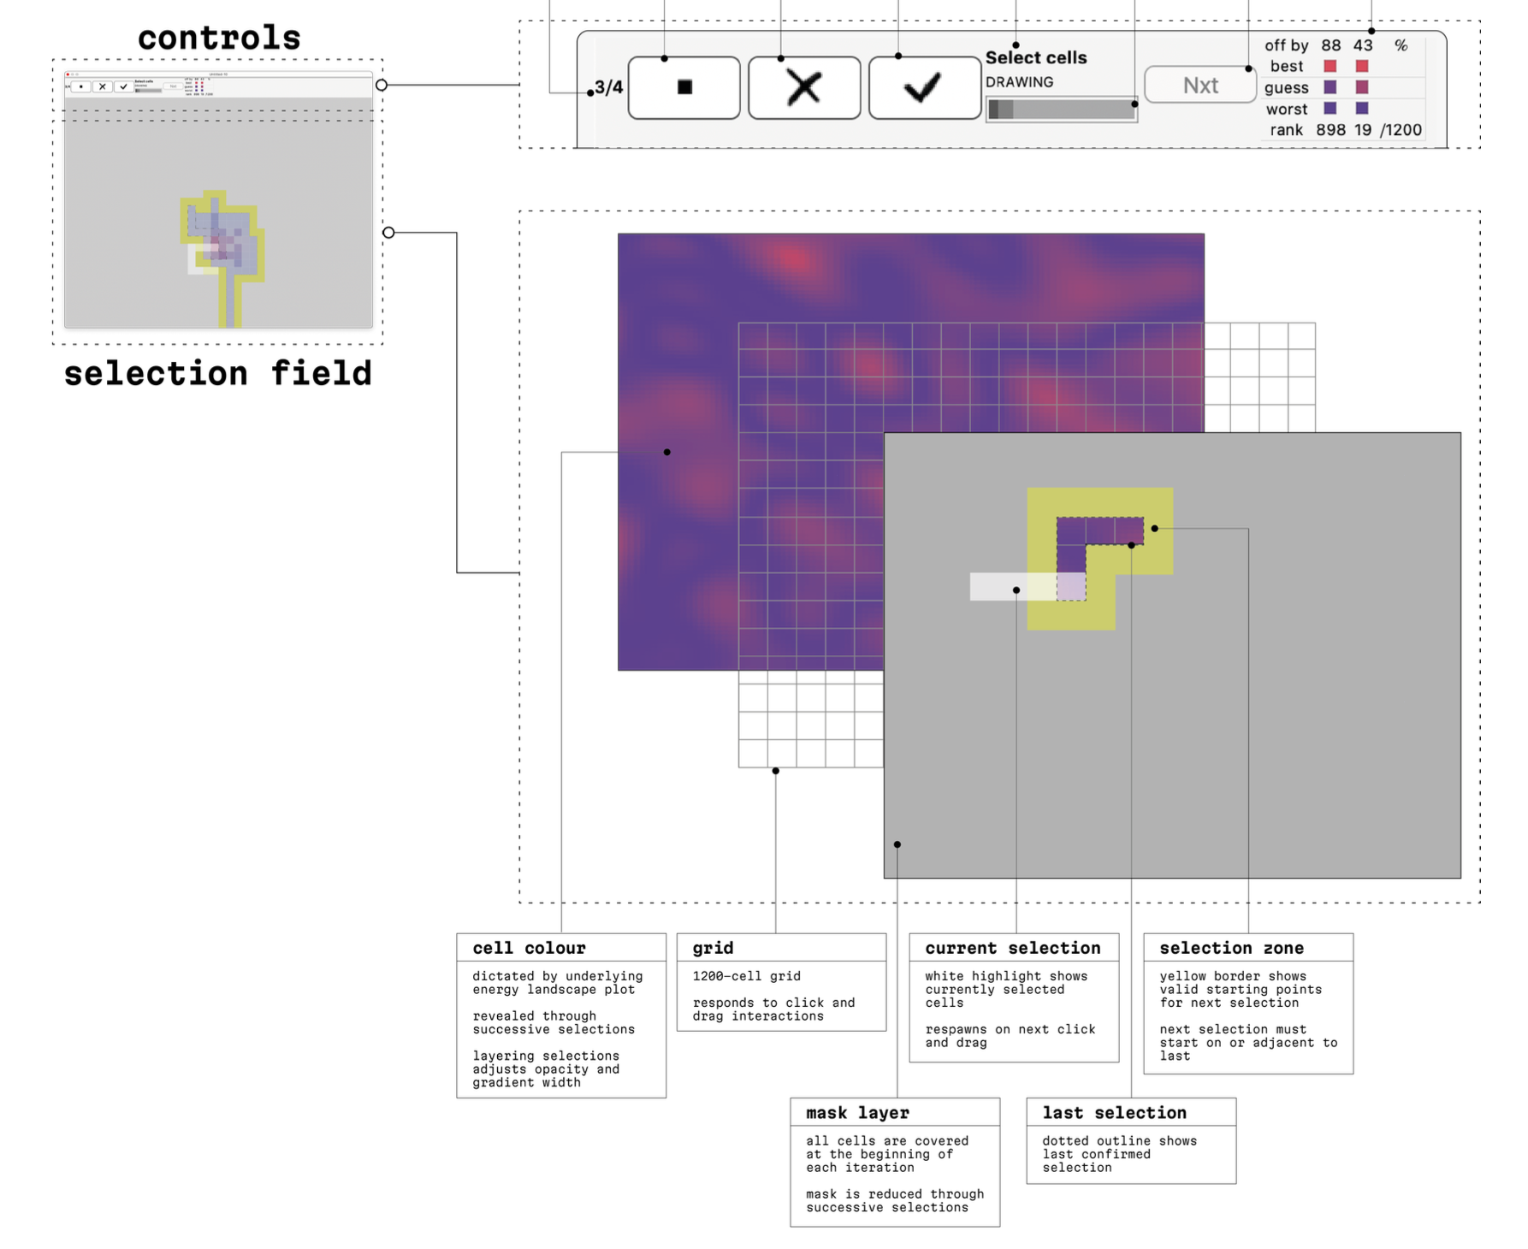
PhD (4/5): Prototype — "Guess a Cell"
Storyboard: learner navigates rounds of "find the most red cell", scores improve, landscape reveals
Annotated interface: controls, grid, mask layer

Slide 10
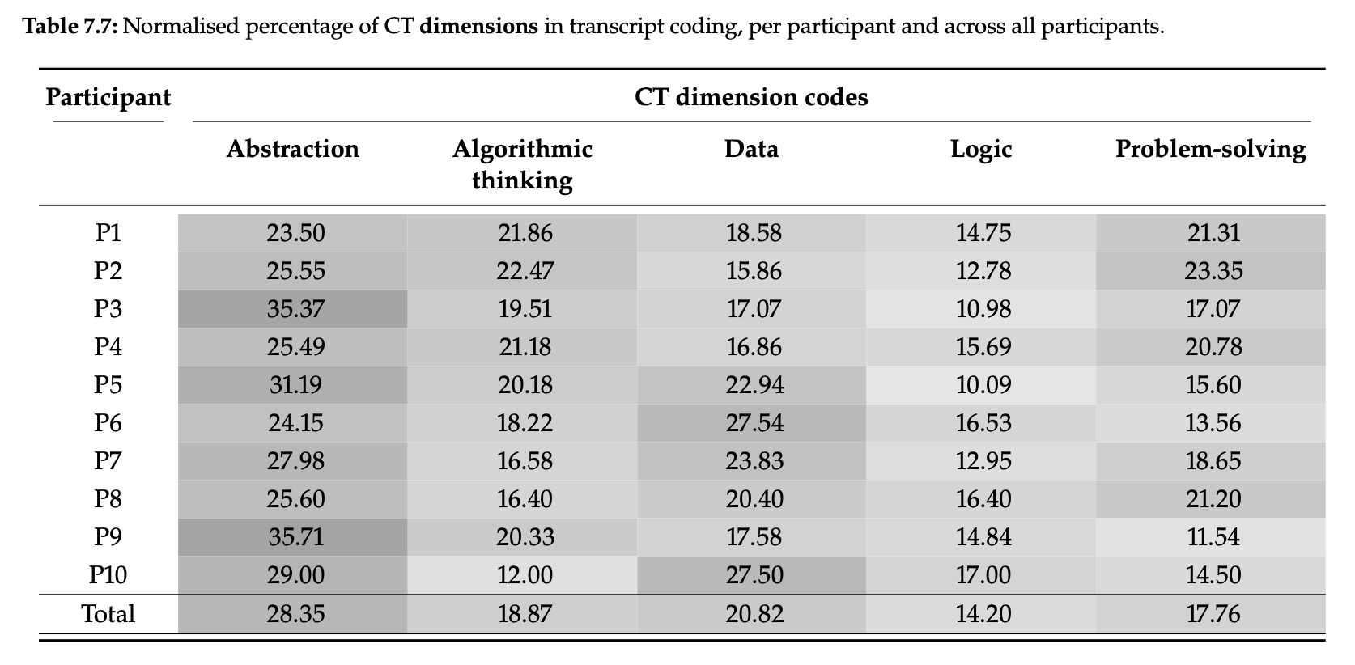
PhD (5/5): Evaluation Results
STUDY DESIGN
• 10 participants with computing background, no QC knowledge
• Think-aloud protocol
• Deductive coding against QCT framework
All 7 QC concepts and all 5 CT dimensions identified in every transcript.
CT DIMENSION BREAKDOWN
Abstraction 28% · Data 21% · Algorithmic 19% · Problem-solving 18% · Logic 14%
Participants connected multiple QC concepts through the shared metaphor system without explicit instruction.
CT dimension percentages per participant (Table 7.7)

Slide 11
What if AI could be
the quantum interface?
FROM METAPHORS TO AGENTS

Slide 12
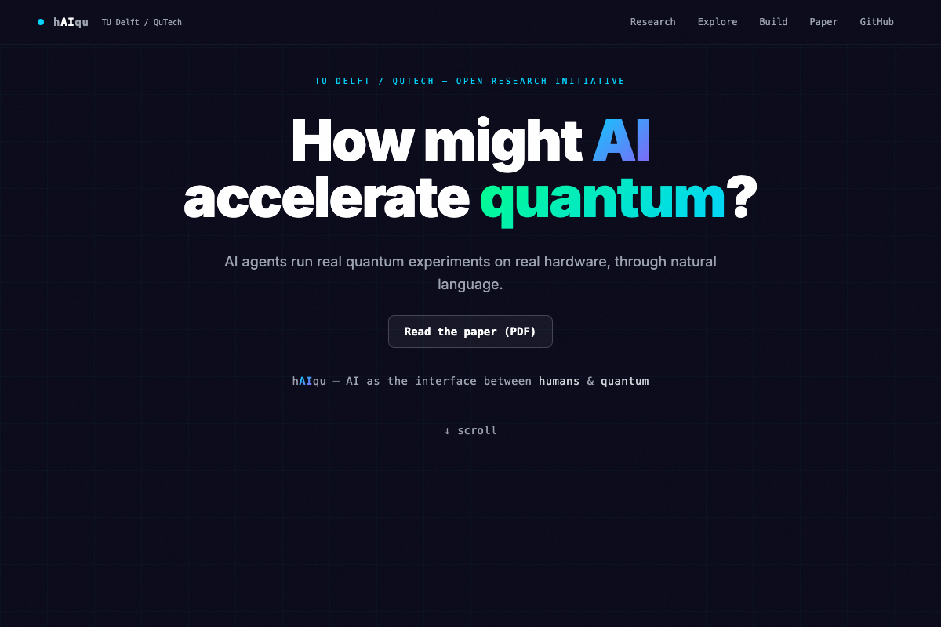
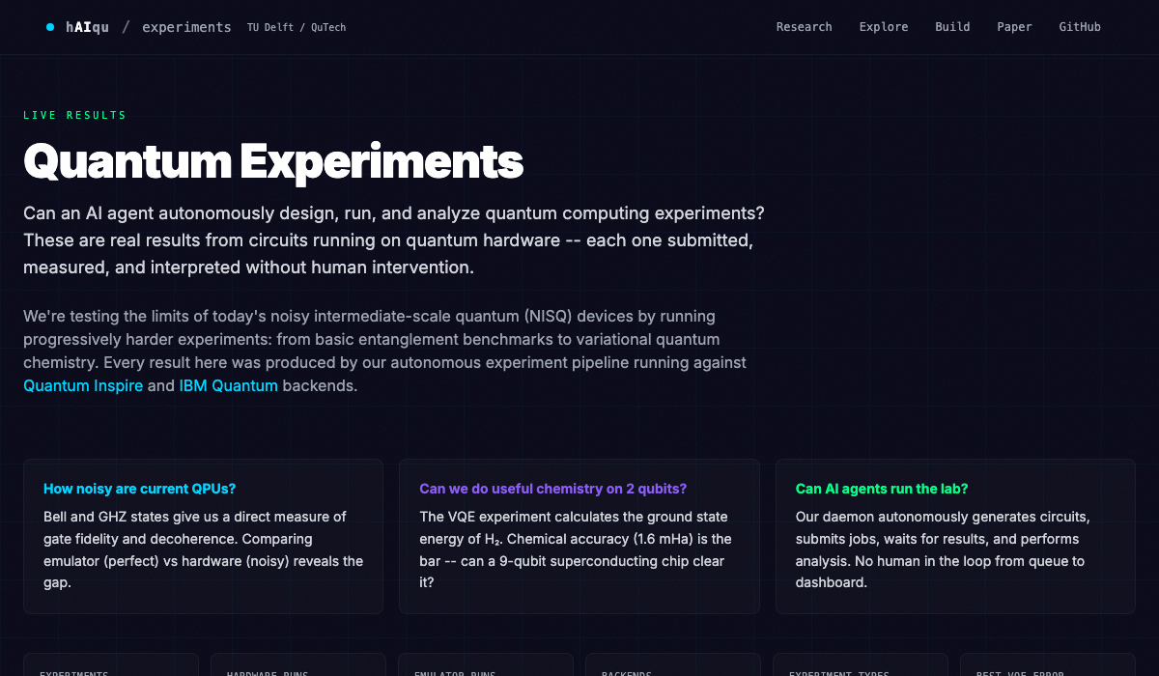
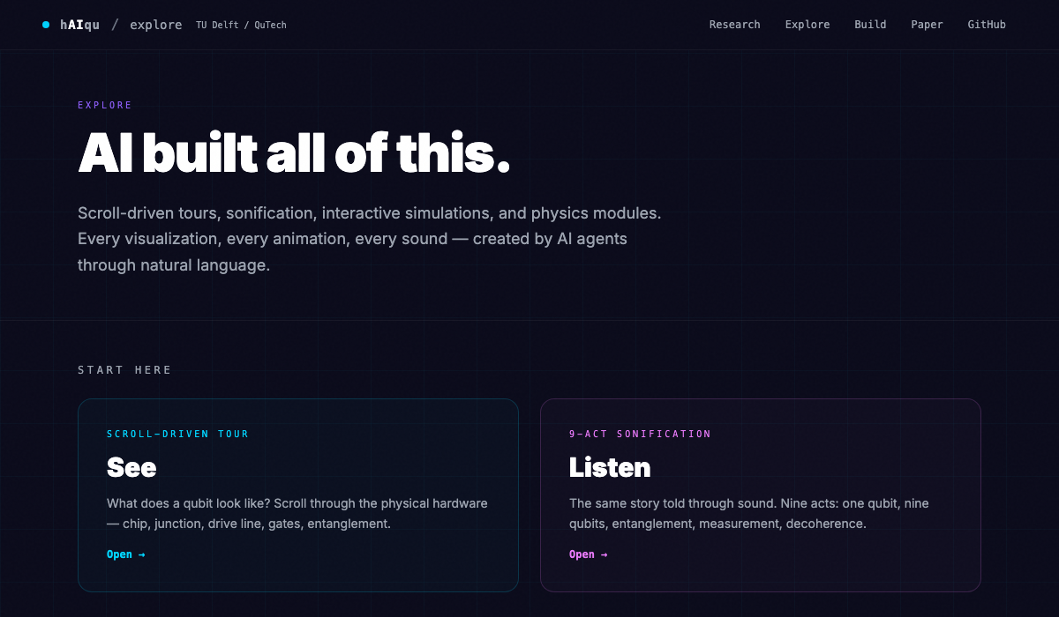
haiqu.org — AI Meets Quantum Hardware
haiqu.org is the interface between people and quantum computers — ask a question in plain language, get results from real hardware.
Interactive dashboard — experiments, results, visualisations.
All built by AI agents through natural language.

Slide 13

MSc: Can ChatGPT Make QC Accessible?
C. D'Arcangelis (2024, supervised with Deborah Nas)
RESEARCH QUESTION
How might ChatGPT improve the accessibility of quantum computing?
FINDINGS
• ChatGPT as effective intermediary for democratising QC access
• Benefits at all skill levels: beginners do creative coding, programmers gain QM insight
• Created "Quantum Buddy 2.0" — custom GPT refined for non-experts
• Non-experts solved encryption problems with no QM background
Early evidence that LLMs can function as an accessibility layer for quantum computing.
AI as the interface between humans and quantum hardware

Slide 14
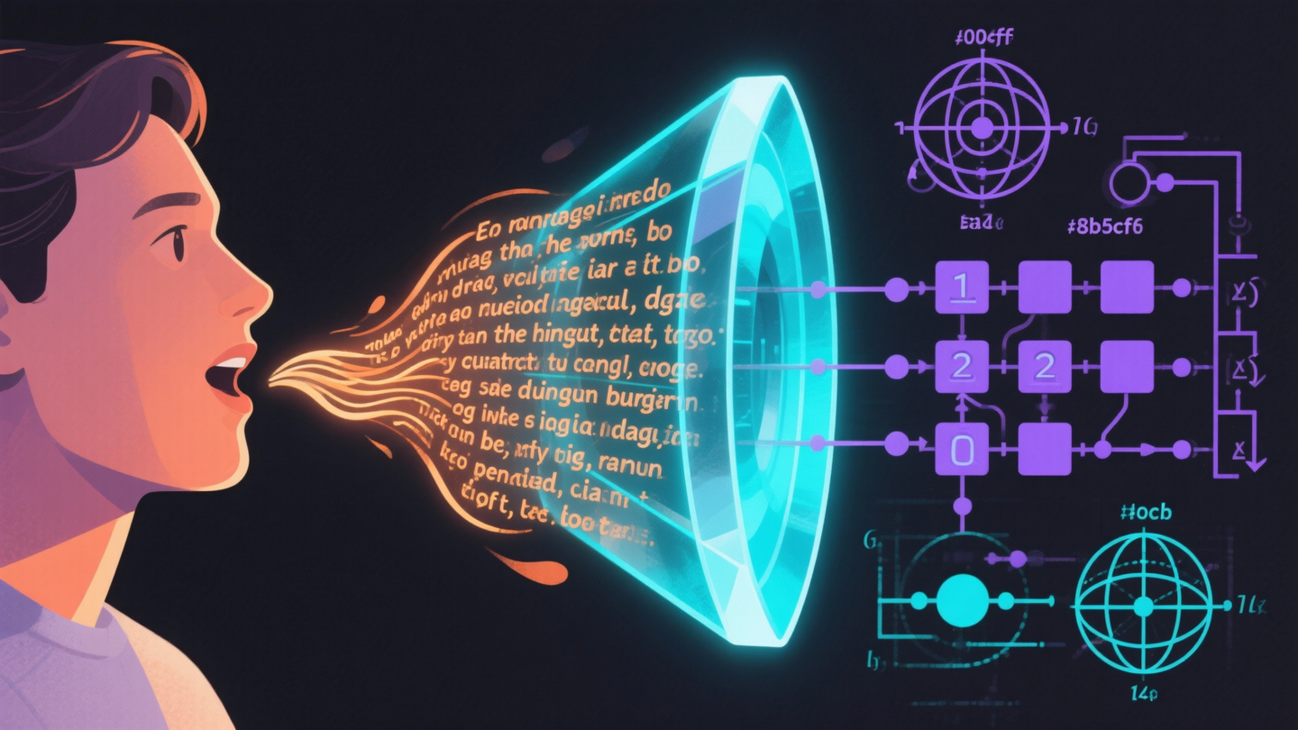
Haiqu: How Good Is AI at Quantum?
QISKIT HUMANEVAL (IBM, 2024)
151 quantum programming tasks. LLMs achieve 62–71% zero-shot, 79.5% with retrieval augmentation.
OUR REPLICATION STUDY
Go beyond code generation: can an AI agent replicate published experiments on real hardware, end-to-end?
Replication is some of the easiest science to do — the protocol exists, the claims are defined. If AI can do this, it validates the approach. In the hands of experts, the same tools could accelerate greenfield science.

Slide 15
AI Agent Results
"Make real qubits available to users in society... such that those users can experience quantum computing first hand."
Human asks questions
→
AI Agent builds circuits, runs jobs
→
3 Quantum Chips Tuna-9 · Garnet · Torino
93%
6
0
230K+
claims replicated (25/27)
landmark papers
circuits by human
measurement shots

Slide 16
Deliverables Scorecard
Grant promise | Status | Delivered
"PhD thesis (month 48)" | DONE | QCT thesis — 6 RQs, framework, metaphors, prototype (PhD)
"3 scientific publications" | DONE | Thesis chapters (PhD) + AI replication paper (2026)
"Fundamental research on mental models" | DONE | QCT framework + 39 metaphors + 7 designed (PhD); MSc thesis
"Technology probes... co-creation" | DONE | Educator interviews + prototype eval n=10 (PhD); Quantum Buddy (MSc)
"Updated UX and interface" | DONE | AI agent interface + interactive dashboard (haiqu.org)
"Data through public repositories" | DONE | PhD data online (PhD); open-source repo, 98 results, 230K+ shots
"Interfacing to stakeholders" (WP5-7) | ONGOING | AI agent approach opens new pathways

Slide 17
What Remains
"It is essential to find this common ground between the experts developing the technology and prospective users."
OPEN QUESTIONS
WHERE WE NEED YOUR HELP
• Does AI abstraction enable learning or obscure understanding?
• Can QCT metaphors be woven into AI explanations?
• If AI can do replication science, can experts + AI do greenfield science?
• Evaluation partners: test haiqu.org with your students, researchers, or stakeholders
• Domain collaboration: bring your experiments to the AI agent
• WP5-7 integration: connect the AI interface to real stakeholder needs
Try it now at haiqu.org — run a quantum experiment in natural language.
Core tension: An AI that fully abstracts QC is useful. But does it educate? Finding the interface that does both is the remaining challenge.

Slide 18
From Mental Models to
AI-Mediated Quantum Computing
The PhD delivered frameworks, metaphors, and prototypes.
The MSc showed ChatGPT as an accessibility layer.
The AI agent proved it works on real hardware.
Next: connect these streams so AI-mediated quantum computing
is not just powerful, but educational.
J. Derek Lomas — j.d.lomas@tudelft.nl
Caiseal Beardow — c.p.beardow@tudelft.nl
IDE & QuTech, TU Delft · haiqu.org

